Slide 1
4.A.1 Biomolecules
The subcomponents of biological molecules and their sequence determine the properties of that molecule.

Slide 2
Learning Objectives:
LO 4.1 The student is able to explain the connection between the sequence and the subcomponents of a biological polymer and its properties. [See SP 7.1]
LO 4.2 The student is able to refine representations and models to explain how the subcomponents of a biological polymer and their sequence determine the properties of that polymer. [See SP 1.3]
LO 4.3 The student is able to use models to predict and justify that changes in the subcomponents of a biological polymer affect the functionality of the molecule. [See SP 6.1, 6.4]

Slide 3
Question
All organisms are made out of 4 types of biomolecules, what are they?
Give an example of each type of macromolecule.
How are 2 monomers put together? Name the process and describe what happens.

Slide 4
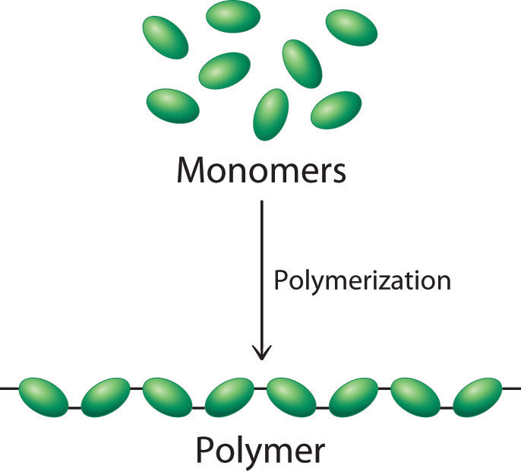
A polymer is a large molecule made from repeating subunits called monomers.

Slide 5
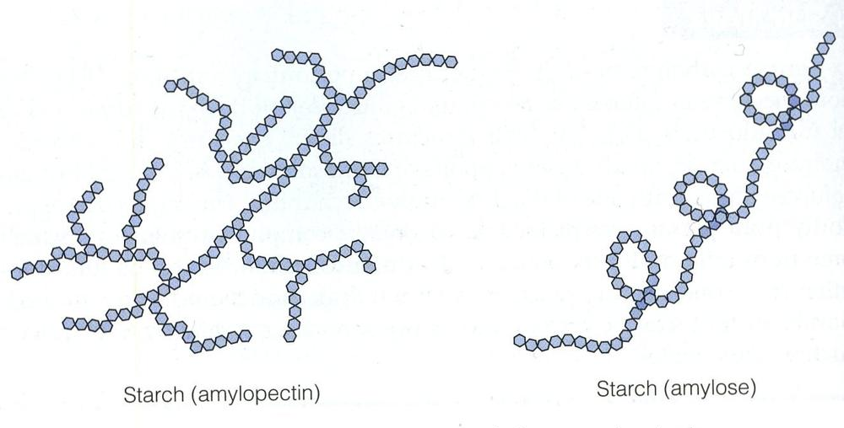
Structure and function of polymers are derived from the way their monomers are assembled.

Slide 6
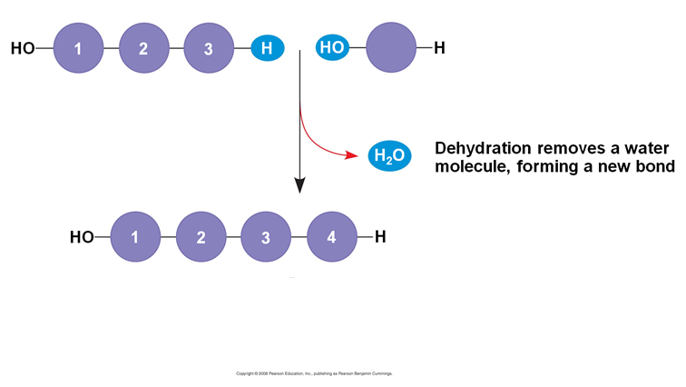
Monomers are assembled into polymers by a condensation reaction, also called a dehydration synthesis reaction. This occurs when two monomers bond together through the loss of a water molecule.

Slide 7
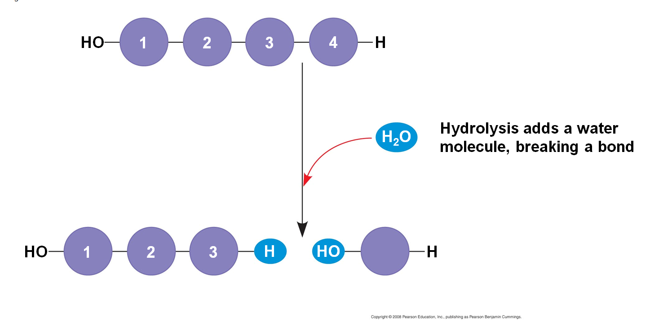
Polymers are disassembled to monomers by hydrolysis, a reaction that is essentially the reverse of the dehydration reaction.

Slide 8
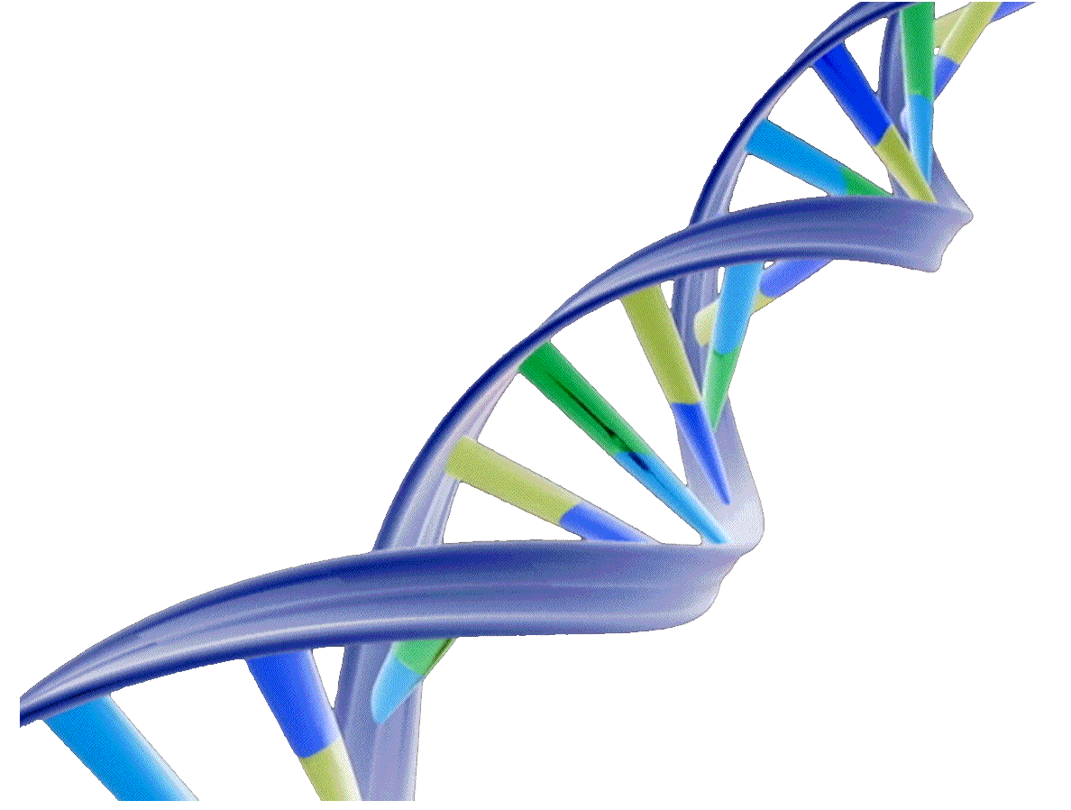
Nucleic Acids

Slide 9
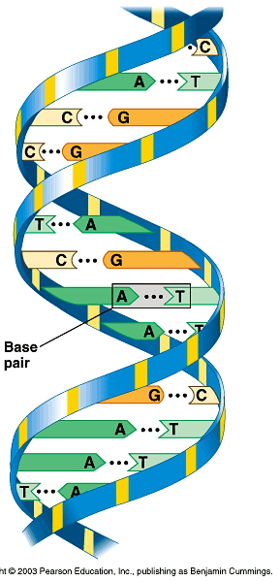
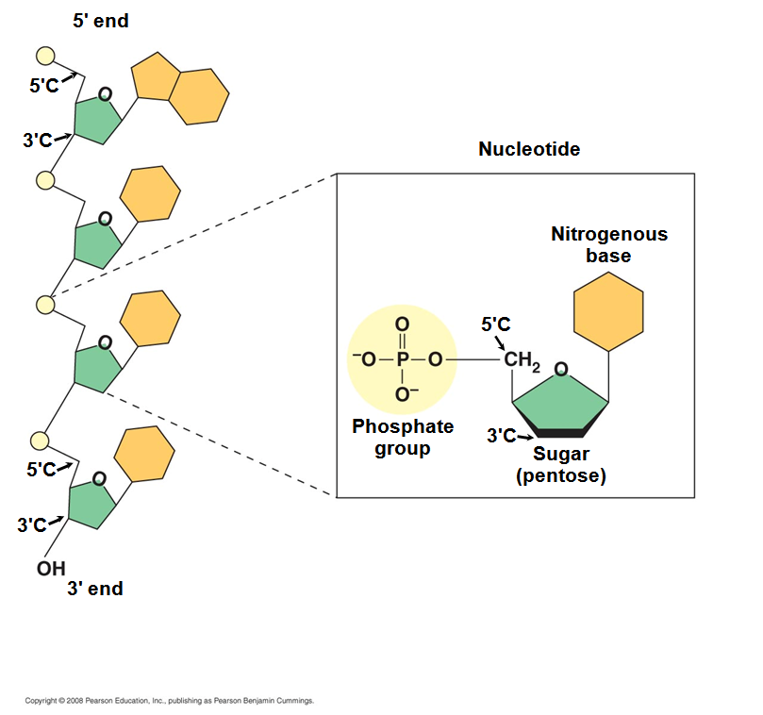
In nucleic acids, biological information is encoded in sequences of monomers called nucleotides.

Slide 10
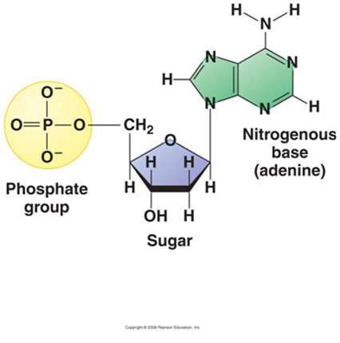
Each nucleotide has the following structural components:
a five-carbon sugar
a phosphate group
a nitrogen base

Slide 11
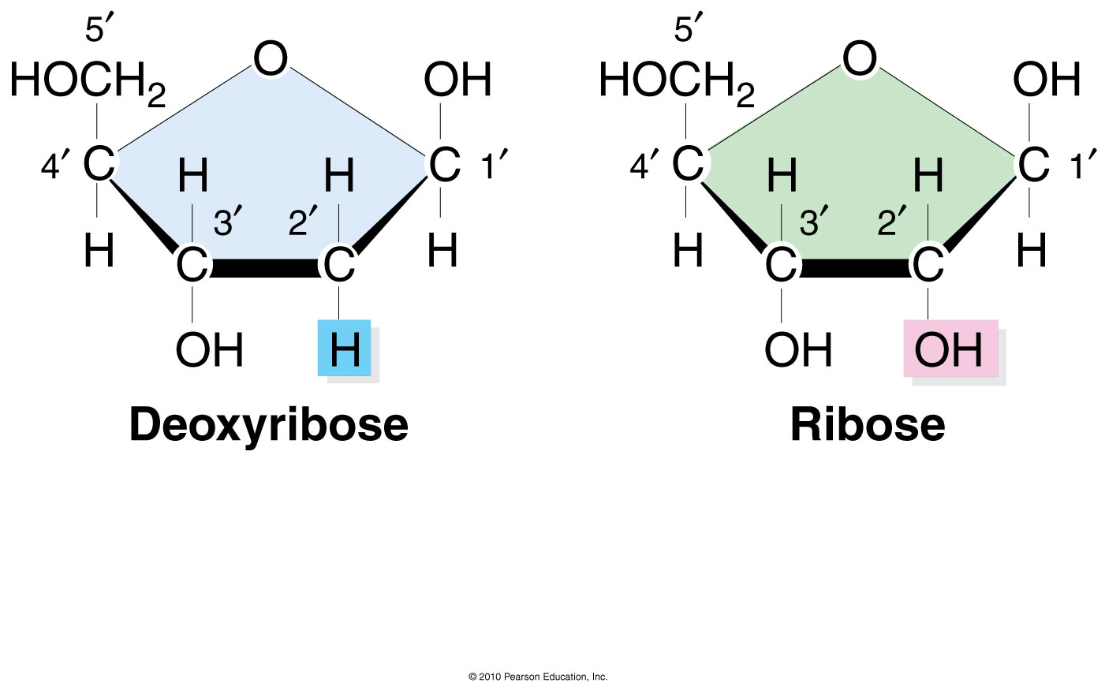
Deoxyribose sugar is in DNA and ribose sugar is in RNA.

Slide 12
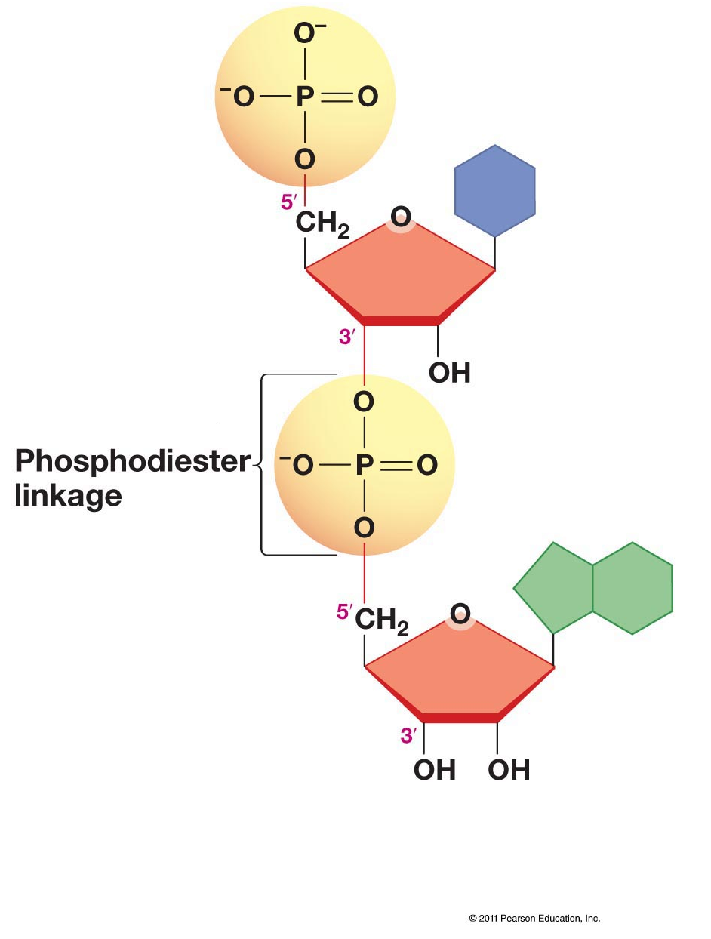
The bonds that connect nucleotides are called phosphodiester bonds.

Slide 13
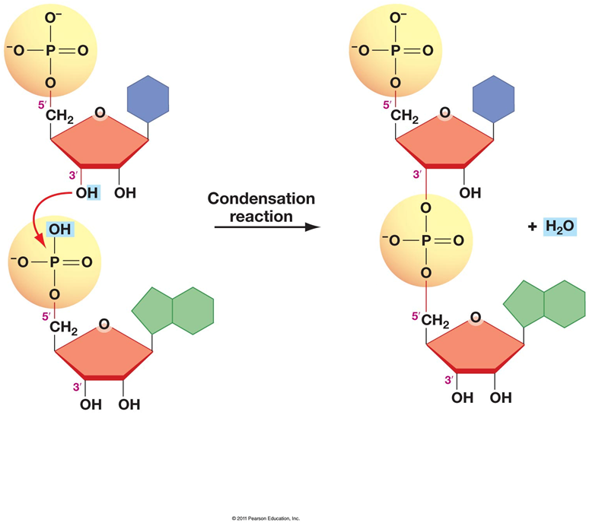
Phosphodiester bonds form by condensation reactions.

Slide 14
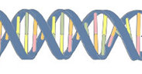
DNA and RNA differ in function and differ slightly in structure. These structural differences account for the differing functions.
DNA
RNA
Deoxyribose sugar
Thymine
Shape: double helix
Ribose sugar
Uracil
Shape: single strand

Slide 15
Question
If a strand of DNA has the nitrogen base sequence 5'-ATTTGC-3', what will be the sequence of the matching strand?
A. 3'-TUUUCG-5'
B. 3'-ATTTGC-5'
C. 3'-GCAAAT-5'
D. 3'-TAAACG-5'
E. 3'-UAAACG-5'
Notes:
D.

Slide 16
Question
The two strands of a DNA double helix are held together by _____ that form between pairs of nitrogenous bases.
a. hydrophilic interactions
b. hydrogen bonds
c. ionic bonds
d. covalent bonds
e. S—S bonds
Notes:
b.

Slide 17
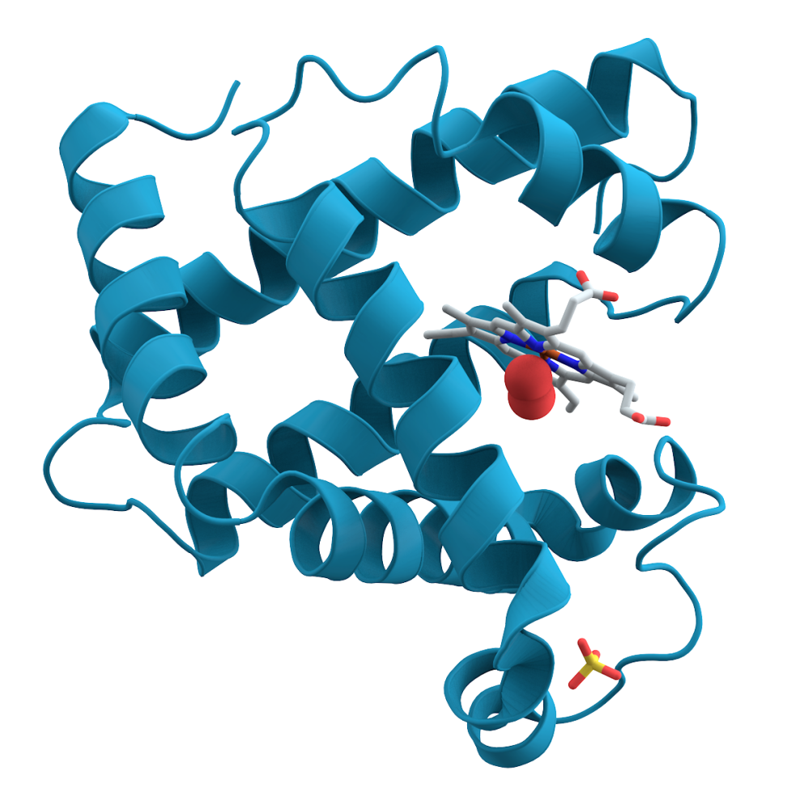
Proteins

Slide 18
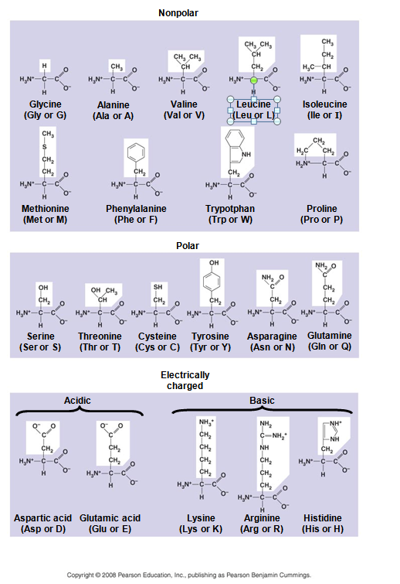
Proteins are derived from polypeptides, which are polymers built from the same set of 20 amino acids.

Slide 19
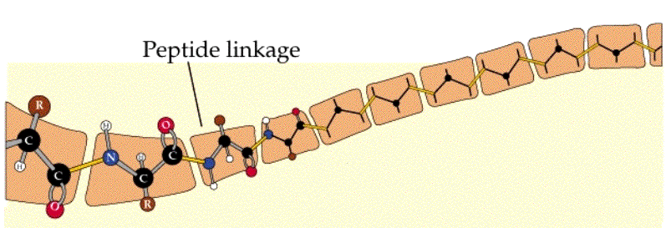
In proteins, the specific order of amino acid monomers in a polypeptide interacts with the environment to determine the overall shape of the protein.

Slide 20
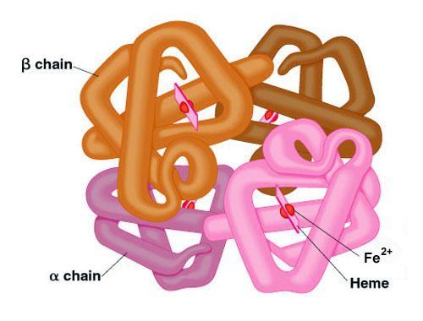
A functional protein consists of one or more polypeptides twisted, folded, and coiled into a unique shape.

Slide 21
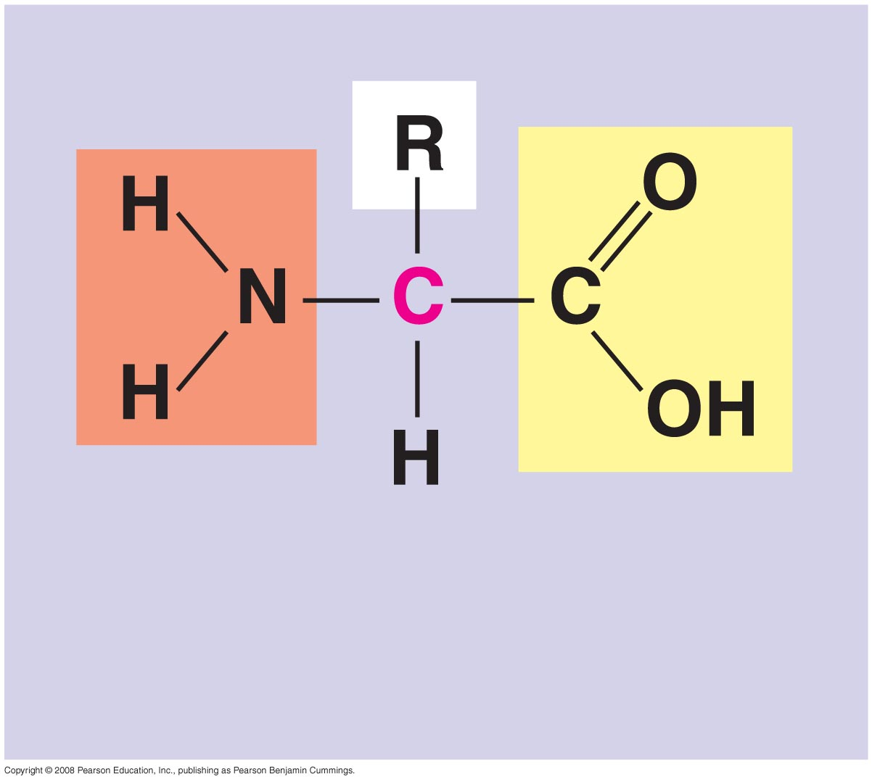
An amino acid contains an amino group, a carboxyl group, and an R group attached to a central carbon.
Amino Group
Carboxyl Group

Slide 22
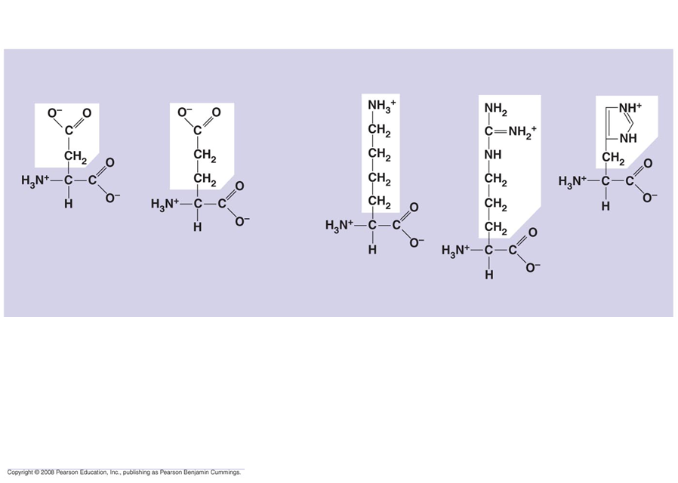
Amino acids differ in their properties due to differences in their R groups, also called side chains.
Amino Acids with Electrically Charged Side Chains
Aspartic acid
Glutamic acid
Lysine
Arginine
Histidine

Slide 23
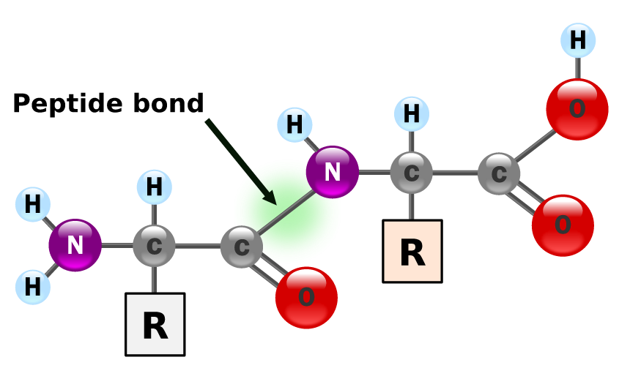
Amino acids are linked by peptide bonds.

Slide 24
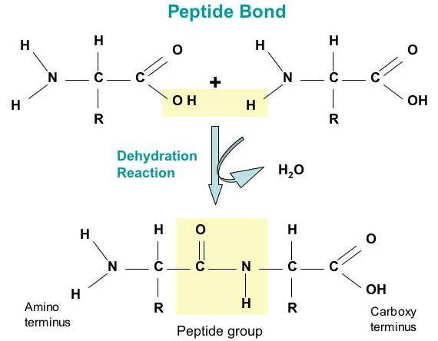
Peptide bonds form from condensation, or dehydration synthesis, reactions.

Slide 25
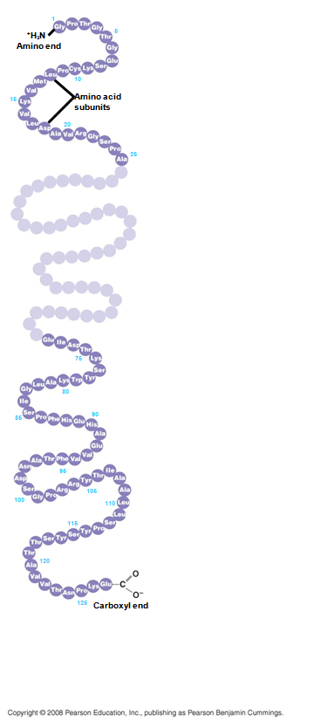
A polypeptide chain is the primary structure of the protein.

Slide 26
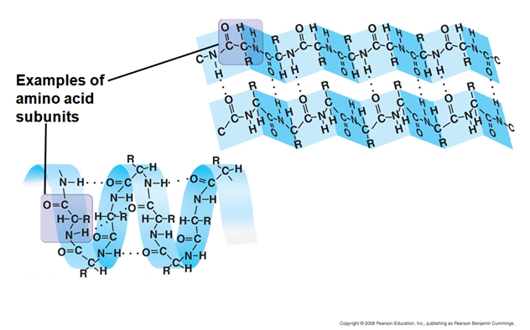
The secondary structure of a protein result from hydrogen bonds between amino acids. Typical secondary structures are a coil called an α helix and a folded structure called a β pleated sheet.
β pleated sheet
α helix

Slide 27
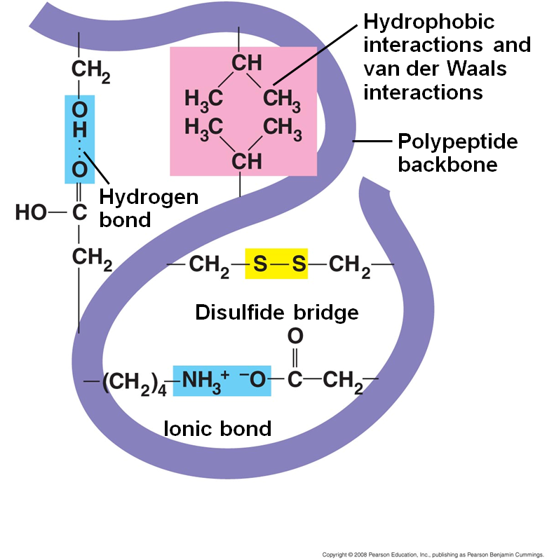
Tertiary structure is determined by interactions between R groups. These interactions include hydrogen bonds, ionic bonds, hydrophobic interactions, and van der Waals interactions. Strong covalent bonds called disulfide bridges may reinforce the protein’s structure.

Slide 28
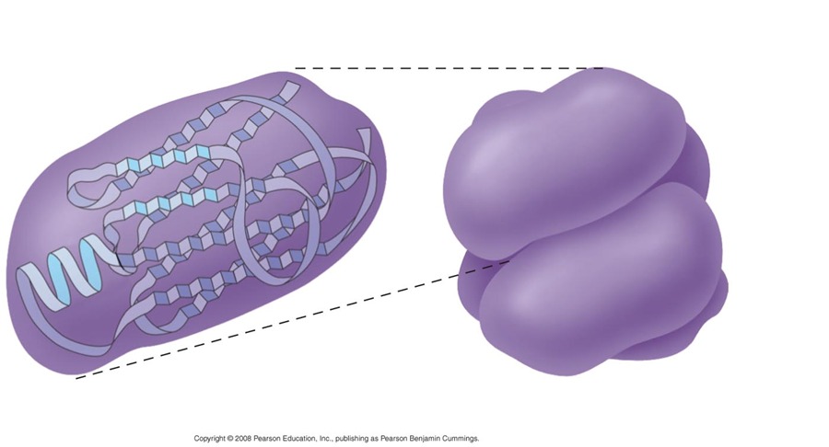
Quaternary structure results when two or more polypeptide chains form one macromolecule.

Slide 29
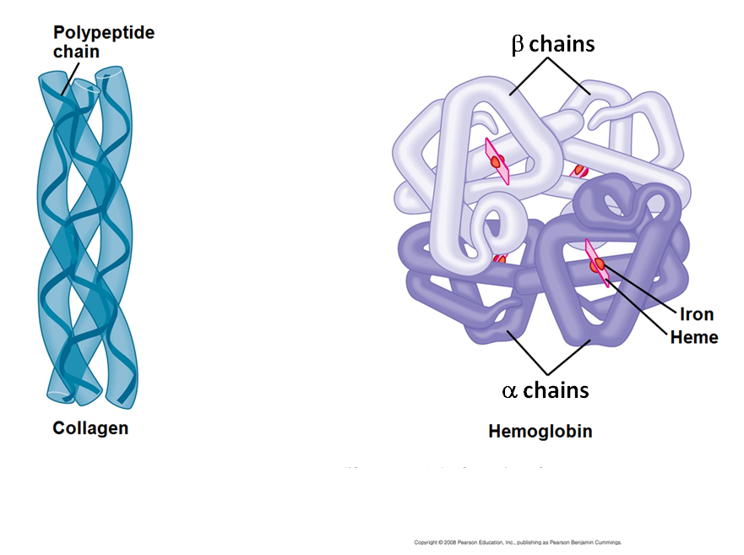
Collagen is a fibrous protein consisting of three polypeptides coiled like a rope. Hemoglobin is a globular protein consisting of four polypeptides: two alpha and two beta chains.

Slide 30
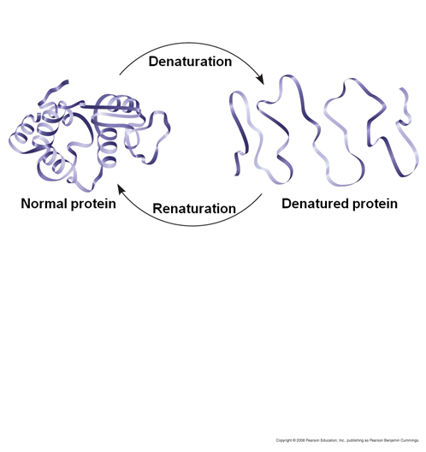
This loss of a protein’s native structure is called denaturation. A denatured protein is biologically inactive.
Proteins are affected by changes in:
pH
Salt concentration
Temperature
Other environmental

Slide 31
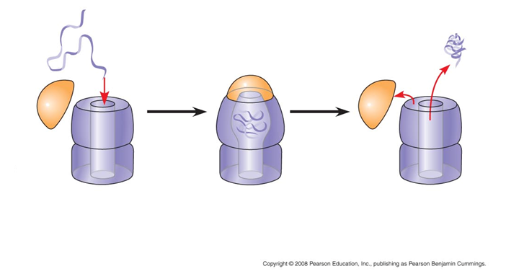
Most proteins probably go through several states on their way to a stable structure. Chaperonins are protein molecules that assist the proper folding of other proteins.

Slide 32
What type of bond joins the monomers in a protein's primary structure?
a. peptide
b. ionic
c. hydrogen
d. S - S
e. hydrophobic

Slide 33
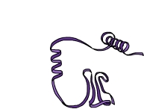
Which of these illustrates the secondary structure of a protein?

Slide 34
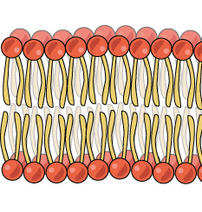
Lipids

Slide 35
Lipids are the one class of large biological molecules that do not form polymers. The most biologically important lipids are fats, phospholipids, and steroids.

Slide 36
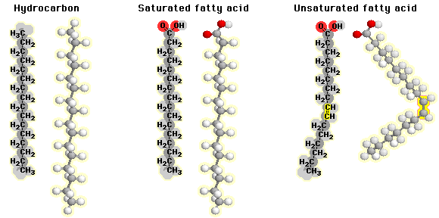
In general, lipids are nonpolar, having little or no affinity for water. Lipids are hydrophobic because they consist mostly of hydrocarbons, which form nonpolar covalent bonds.

Slide 37
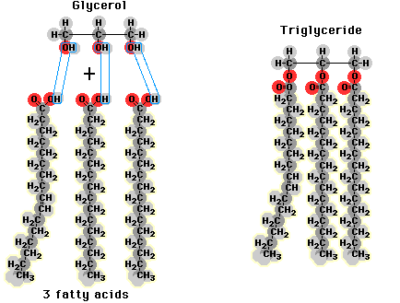
Fats are constructed from two types of smaller molecules: glycerol and fatty acids.

Slide 38
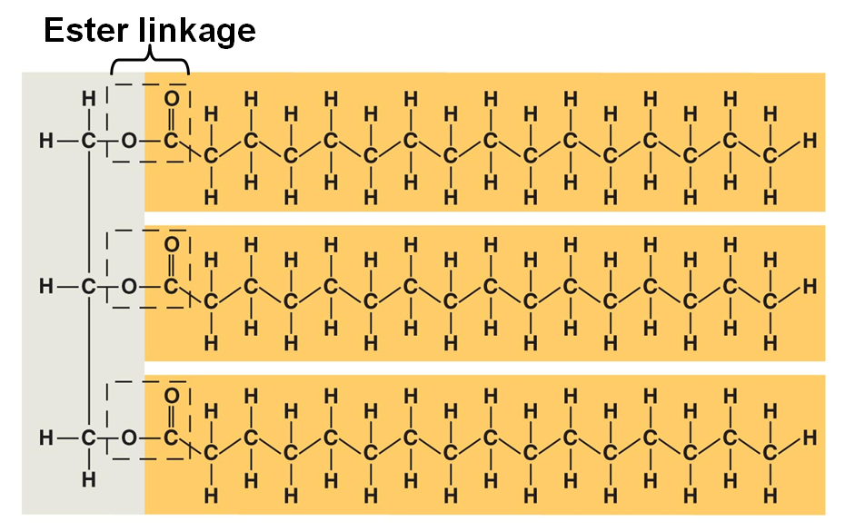
Fatty acids are bonded to the glycerol molecule by ester bonds.

Slide 39
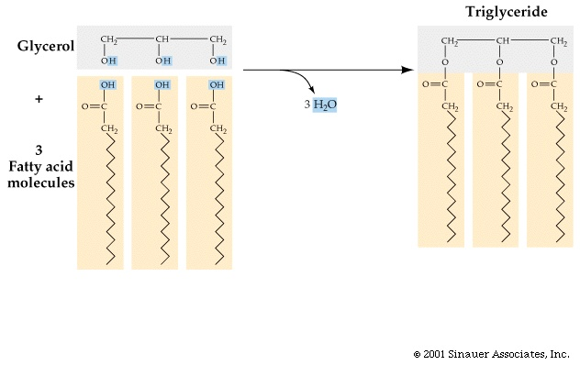
The formation of ester linkages is a dehydration synthesis reaction.

Slide 40
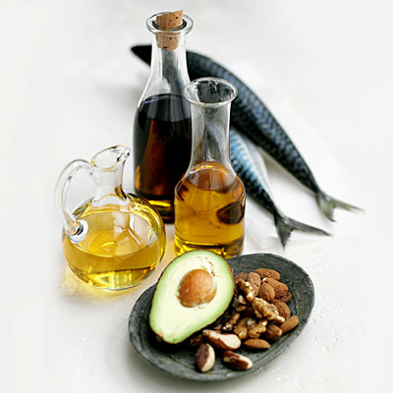
Differences in saturation determine the structure and function of lipids.

Slide 41
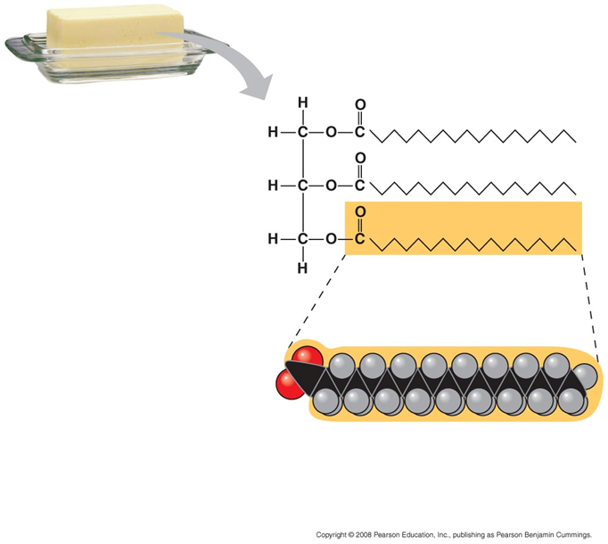
Saturated fatty acids have the maximum number of hydrogen atoms possible and no double bonds.

Slide 42
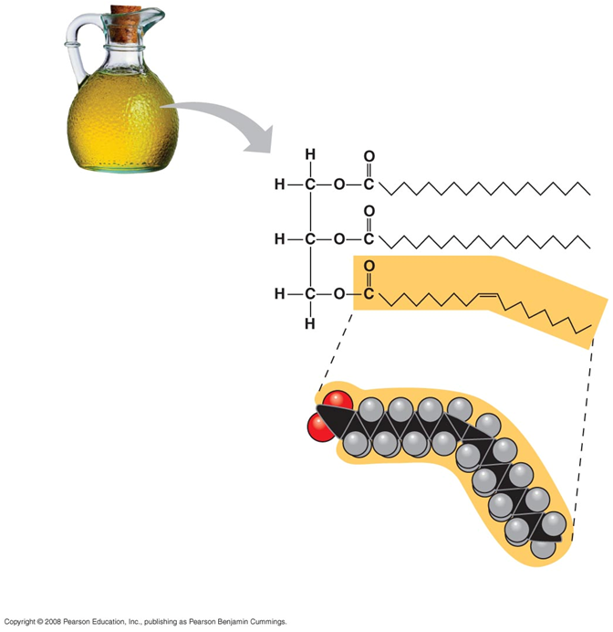
Unsaturated fatty acids have one or more double bonds. This results in a bent structure.

Slide 43
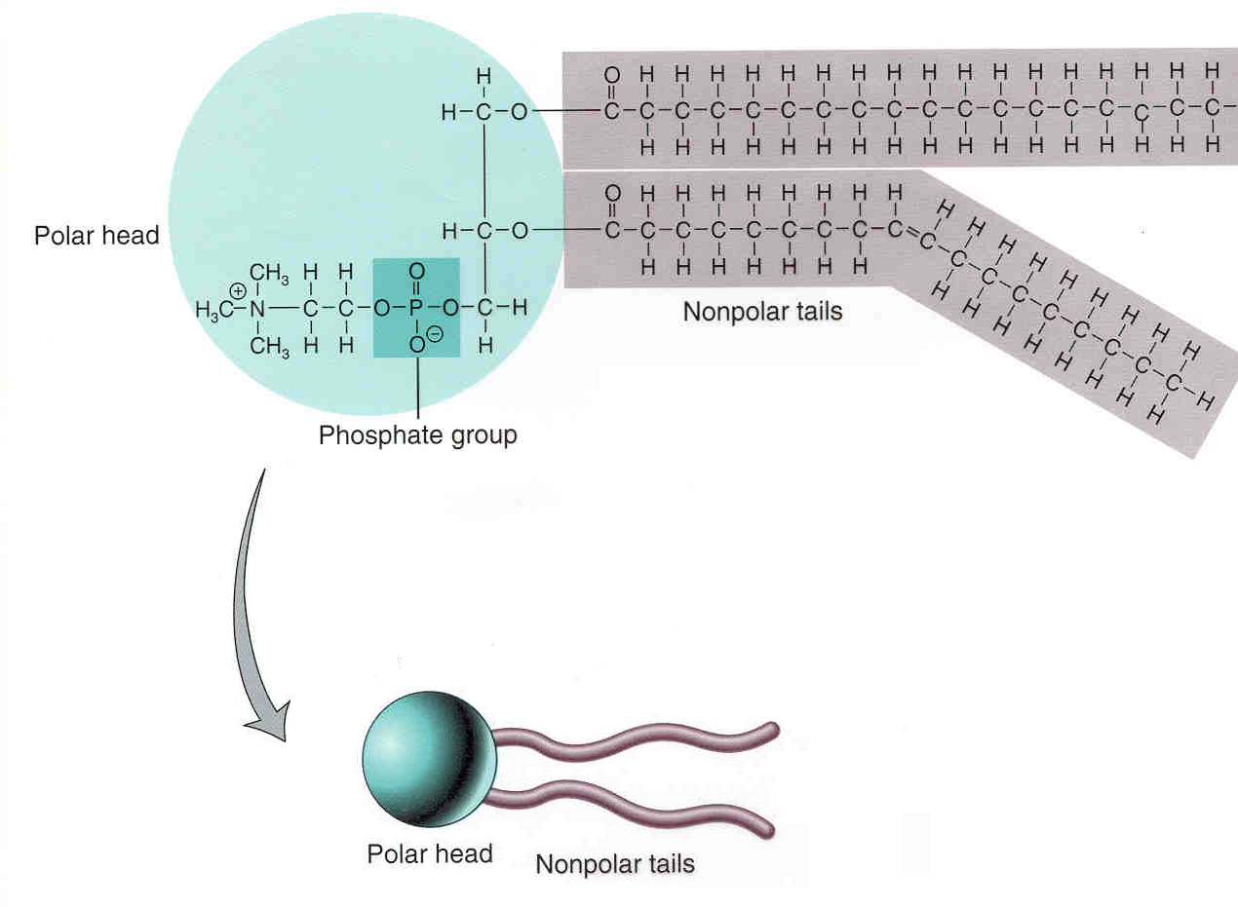
Phospholipids have polar regions that interact with other polar molecules such as water. They also have nonpolar regions that do not interact with water.

Slide 44
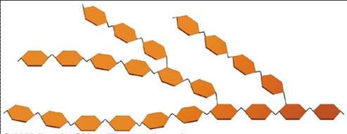
Carbohydrates

Slide 45
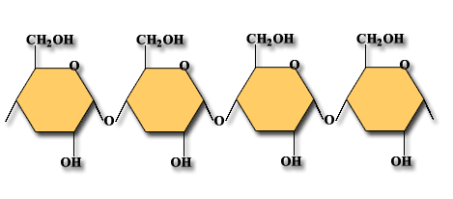
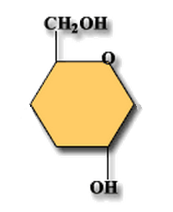
Carbohydrates include sugars and the polymers of sugars. The monomers of carbohydrates are monosaccharides, or simple sugars. Carbohydrate polymers are called polysaccharides.
Monosaccharide
Polysaccharide

Slide 46
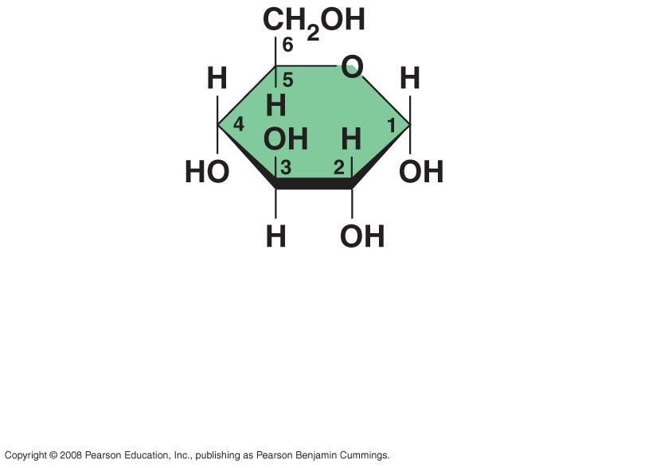
Monosaccharides have molecular formulas that are usually multiples of CH₂O. Glucose (C₆H₁₂O₆) is the most common monosaccharide.
Glucose

Slide 47
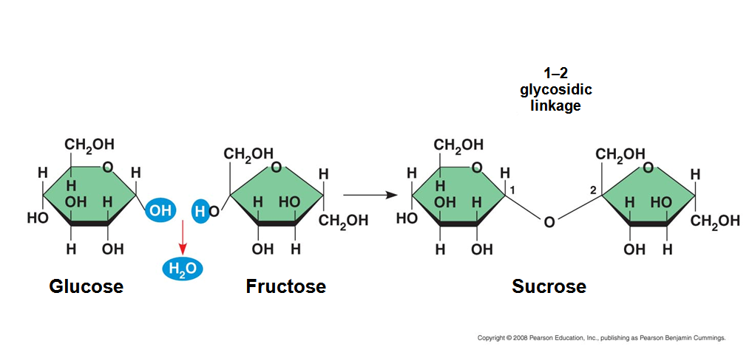
Polysaccharides have storage and structural roles. The structure and function of a polysaccharide are determined by its sugar monomers and the positions of glycosidic linkages.

Slide 48
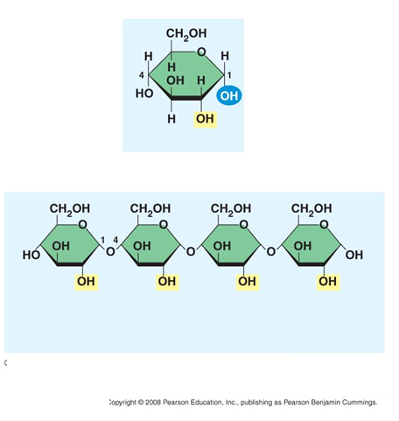
Starch, a storage polysaccharide of plants, is constructed of monomers of α glucose. Plants store starch as granules within chloroplasts and other plastids.
α glucose
Starch, made from 1-4 α glycosidic linkages

Slide 49
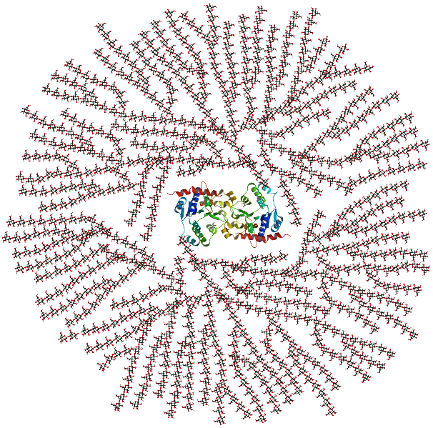
Glycogen, a storage polysaccharide in animals, is made from highly branched chains of α glucose . Glycogen is stored mainly in liver and muscle cells.

Slide 50
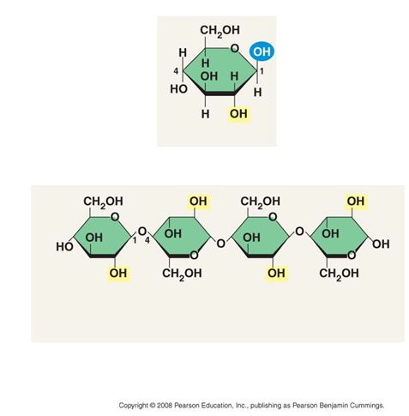
Cellulose is a major component of plant cell walls. Cellulose is a polymer of β glucose, and is not digestible by animals.
β glucose
Cellulose, made from 1-4 β glycosidic linkages

Slide 51
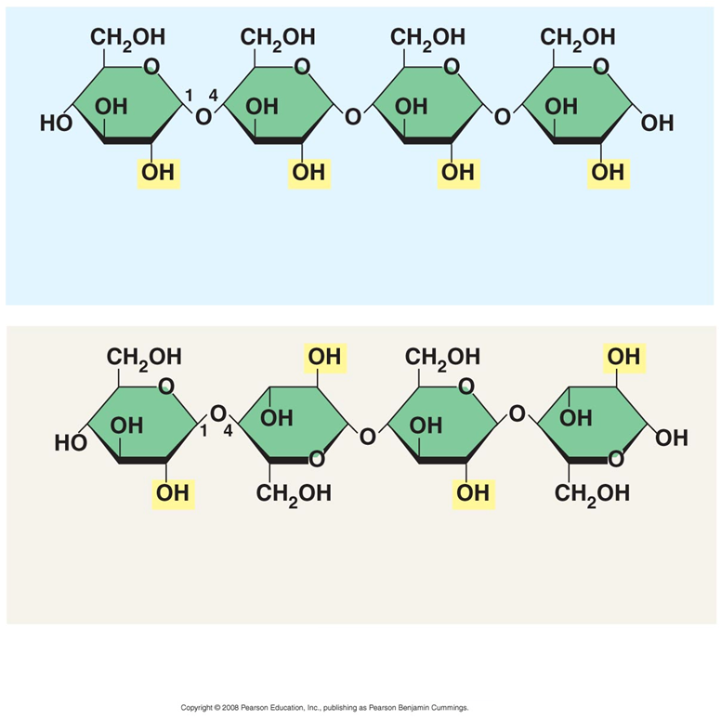
Starch vs. Cellulose
Starch, made from 1-4 α glycosidic linkages
Cellulose, made from 1-4 β glycosidic linkages

Slide 52
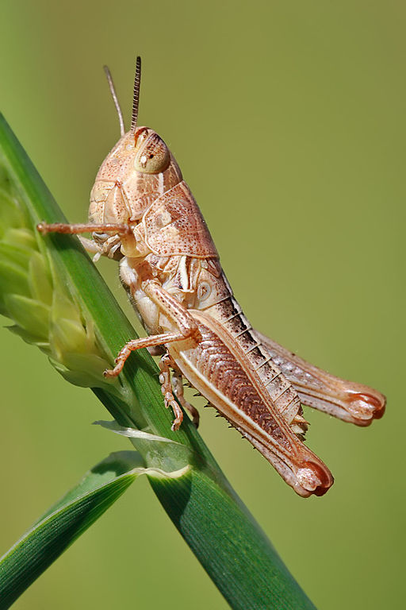
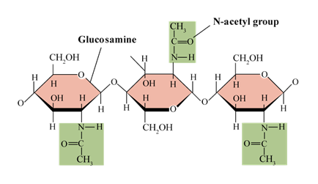
Chitin, a structural polysaccharide, is found in the exoskeleton of arthropods and the cell walls of many fungi.

Slide 53
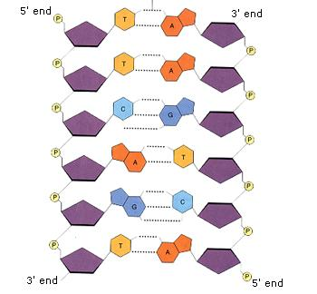
Directionality influences structure and function of polymers. An example is the directionality of DNA that determines the direction in which complementary nucleotides are added during DNA synthesis.

Slide 54
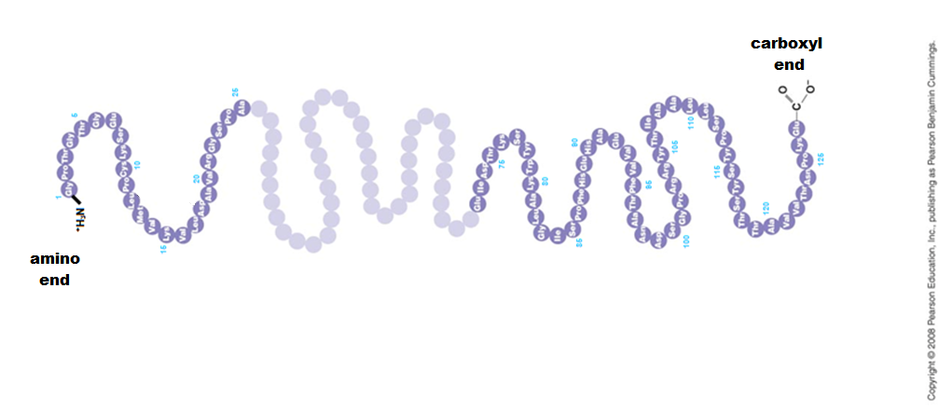
Proteins have an amino end and a carboxyl end.

Slide 55
The type of bonds between monosaccharides determines their relative orientation in a carbohydrate. This then determines the secondary structure of the carbohydrate.

Slide 56
Question
If plants perform photosynthesis to make the carbohydrate glucose, then where do the other biomolecules come from?

Slide 57
Photosynthesis
Plants break the H₂0 and CO₂ to make new molecules
6 H₂O + 6 CO₂ get rearranged into C₆H₁₂O₆ + 6 O₂

Slide 58
Make New Biomolecules
Plants and animals can make new molecules by rearranging the C,H, O atoms in glucose.
For example, if you take many glucose molecules, you can make a lipid molecule (triglyceride = fat).

Slide 59
Change Biomolecules
One biomolecule, like carbohydrates, can be used to make another biomolecule.
This is done by using C, H, and O atoms in carbohydrates and rearranging those atoms to form a new biomolecule.

